Slide 2
Kanister.io
A CNCF.io Sandbox Project for Application Consistent Backups
Daniil Fedotov Senior Open Source Engineer
@Veeam Kasten daniil.fedotov@veeam.com

Slide 3
Motivation: Data on Kubernetes
Myth: everything is stateless on Kubernetes
Kubernetes cluster and application configuration has state
Secrets, RBAC, DNS, etc
CNCF Study 2020: 55% of respondents running stateful workloads
Audit requirements unsatisfied: proof of point in time cluster state configuration
Myth: with GitOps I can recover a cluster with all applications
Stateful workloads still need to backup artifacts outside the cluster
Audit, forensics, point-in-time recovery concerns are still there
Myth: with public cloud I am protected
Cloud providers recommend you set up disaster recovery
Myth: etcd backups protect Kubernetes data
Etcd restore almost never gets applications into desired state

Slide 4

From Stateless to Stateful
v1.0 July 2015
v1.3 July 2016
v1.9 Dec. 2017
v1.13 Dec. 2018
v1.20 Dec. 2020
Today
Stateless applications
Stateful applications and capabilities
“Cattle” PersistentVolumes
Pet Sets Alpha
StatefulSets GA CSI Alpha
CSI GA Operator Framework
VolumeSnapshot GA
Data Service Maturity
86%
14%
started adopting 2+ years ago¹
started adopting in last two years¹
¹ 2022 Data on Kubernetes Report (N=500+)

Slide 5
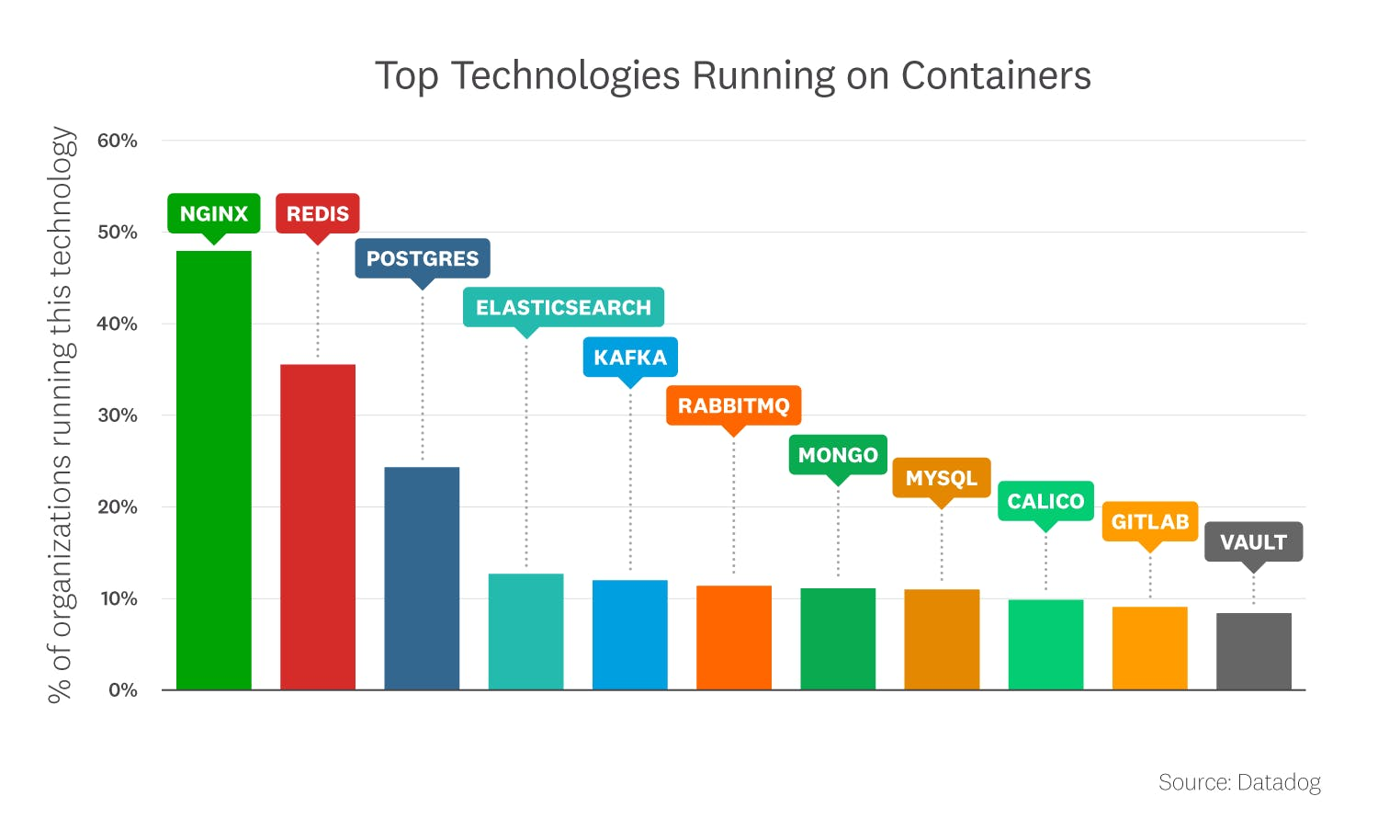
Applications on Kubernetes
Datadog Real-World Container Use Report – Nov 2022

Slide 6



3-2-1 backup rule
Different Copies
Of Data
Different Media
Of which is offsite
Source: The DAM Book: Digital Asset Management for Photographers, Peter Krogh, 2005.
https://community.veeam.com/blogs-and-podcasts-57/3-2-1-1-0-golden-backup-rule-569
https://www.cisa.gov/uscert/sites/default/files/publications/data_backup_options.pdf

Slide 7
The Challenge: Complex Workflows
One application includes many domains
Difficult to separate concerns of different domain experts
Many moving parts
Different types of backups
Logical backups
Volume snapshots
Provider specific API calls – Amazon RDS, data service operators
Application Lifecycle
Scale up/down workloads
Quiesce/Unquiesce
Different types of targets
Object storage
Vendor targets

Slide 8
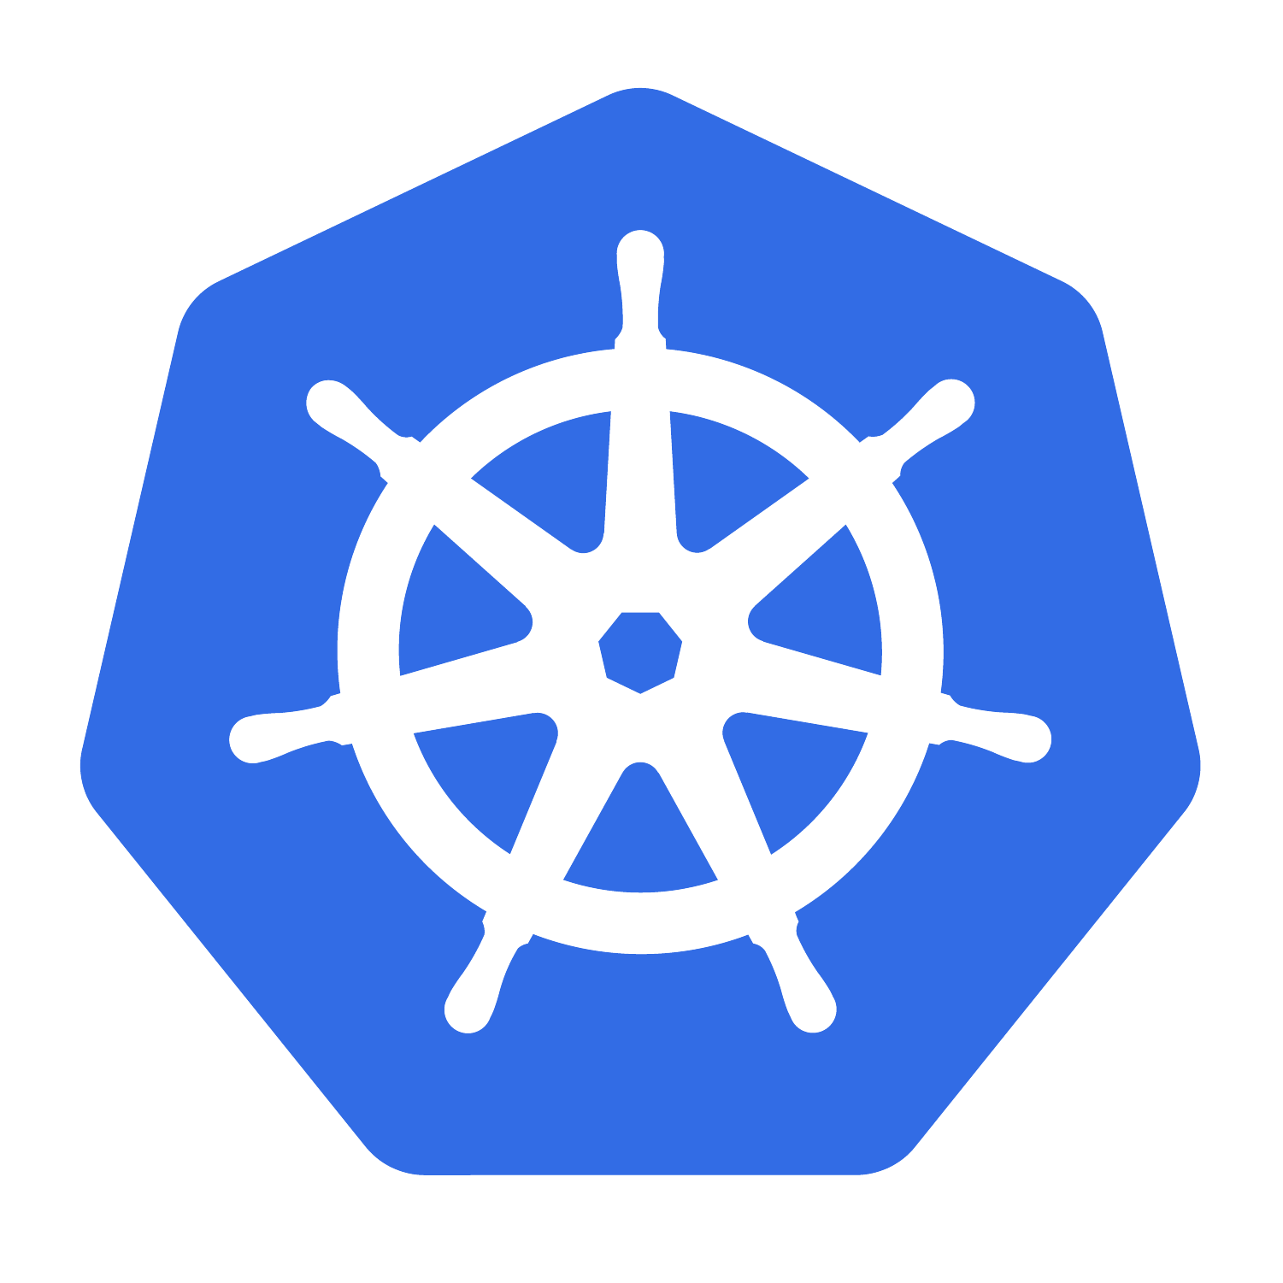


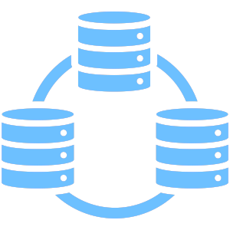
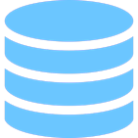
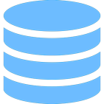
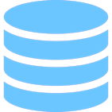
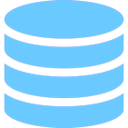

Cloud Native Deployment Patterns
Application using data services outside of Kubernetes
Data services in Kubernetes – separate from Application
Application includes
data services – all in Kubernetes
Kanister.io

Slide 9
The Challenge: Flavours of Data Management
Storage-centric snapshots
Provided by the underlying file or block storage
Crash-consistent
Storage-centric with data service hooks
Freeze/unfreeze data service layer during snapshot process
Data service-centric
Use database specific utilities
mysqldump, pg_dump, mongodump etc.
Application-centric
Exercise all the above capabilities in a coordinated manner

Slide 10








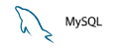
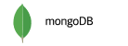
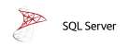



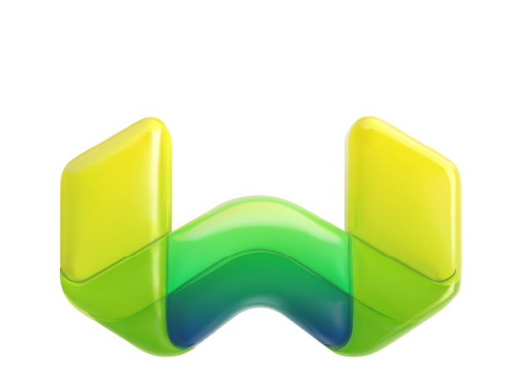
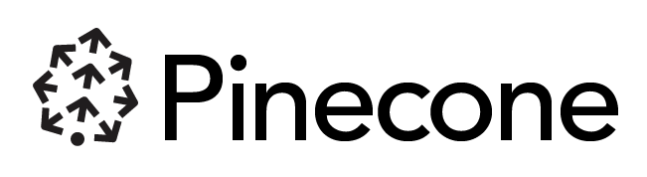

Kanister Contribution to CNCF (Sandbox)
Data on Kubernetes Growth
Databases (SQL/NoSQL) lead the growth of stateful workloads on Kubernetes, database diversity and deployments continue to increase data protection requirements
kanister.io
Kanister.io
Data protection operations in a cloud native, extensible manner for application consistent backup and recovery. Kanister has been an open source project and community since 2017.
Kanister community blueprints:
Amazon RDS
Cassandra
PostgreSQL
MySQL
MongoDB
SQL Server
K8ssandra
Elasticsearch
Rapid Release and Innovation
0.94 Prometheus metrics, OCP 4.13 support, Grype security scanner
0.92 MongoDB Atlas blueprint
0.91 OCP 4.12 support, AWS RDS Postgres blueprint
0.90 Kopia controller, Incremental Elastic blueprint
Growing database diversity, e.g., Vector databases
Weaviate

Slide 11
Kanister.io: CNCF sandbox history
2017: Created & launched @ KubeCon NA
2023-06-20: Submitted to CNCF
2023-09-19: Vote passes for Acceptance https://github.com/cncf/sandbox/issues/46 Project Onboarding: https://github.com/cncf/toc/issues/1172
2023-11-07: Veeam Press Release, adopter and ISV support
Sandbox
Incubating
Graduated
CNCF Project Maturity:

Slide 12
How Kanister.io Orchestrates Data Protection
A Kanister controller, installed by Helm chart, provides new Custom Resource Definitions:
Blueprint
Defines workflows for backup, restore and delete operations
Part of your infrastructure setup
ActionSet
Runs an action to backup, restore and delete
Created on backup and restore action, contains status of operation
Profile
Defines target destination for backups or sources for restores, e.g. S3 bucket

Slide 13
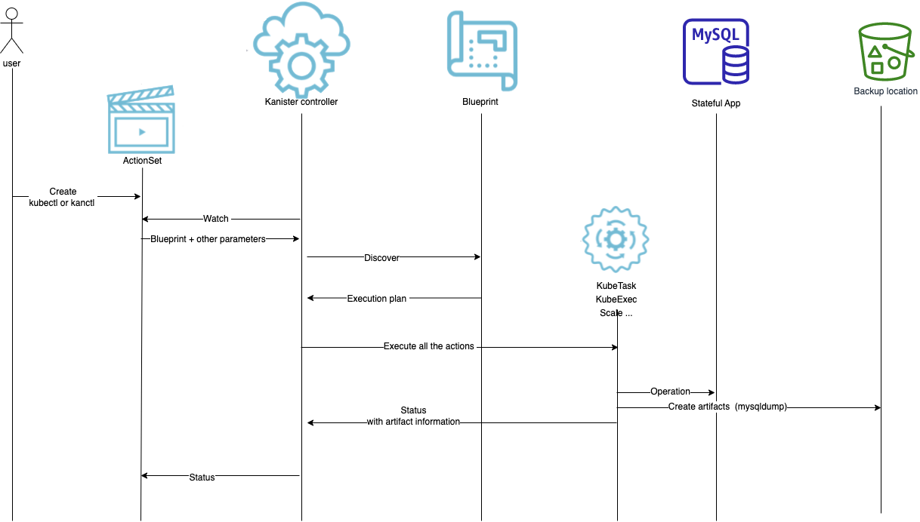
Kanister: in Action

Slide 14
Breaking down the Blueprint

Slide 15
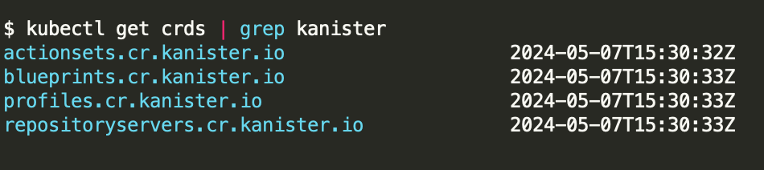
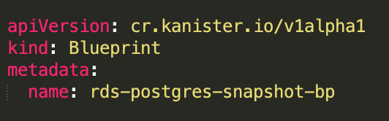
Blueprints are custom resources
https://github.com/kanisterio/kanister/blob/master/examples/aws-rds/postgresql/rds-postgres-snap-blueprint.yaml

Slide 16
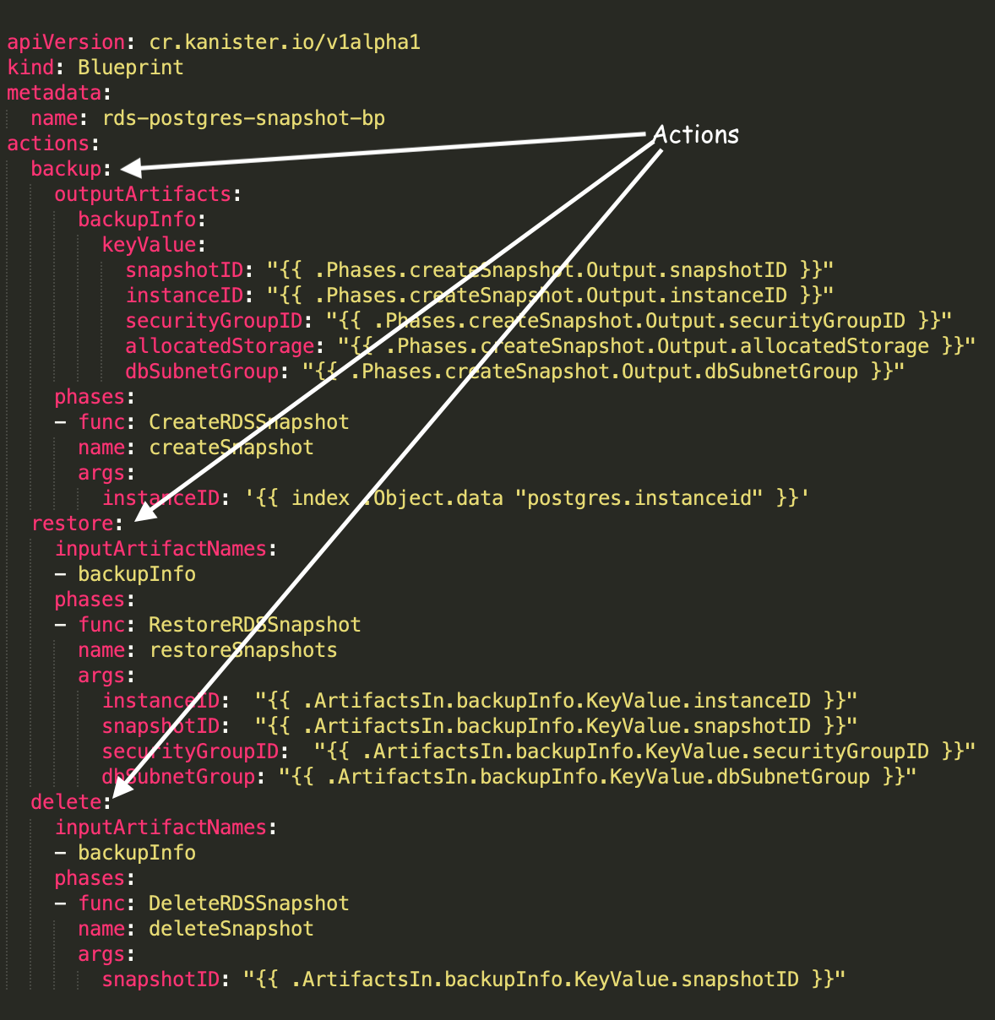
Blueprints are templates for actions
‘backup’, ‘restore’, ‘delete’ are actions
Actions have phases
Each phase executes a Function

Slide 17
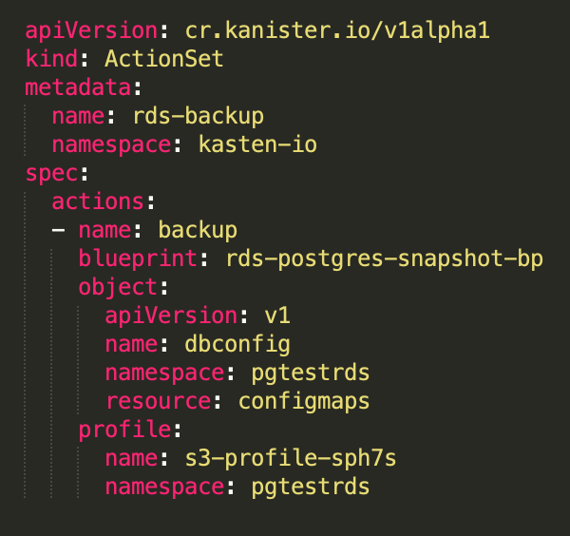
ActionSets execute actions
Target blueprint and action name
Each action provide template values
All actions in actionset execute in parallel
Phases run sequentially

Slide 18
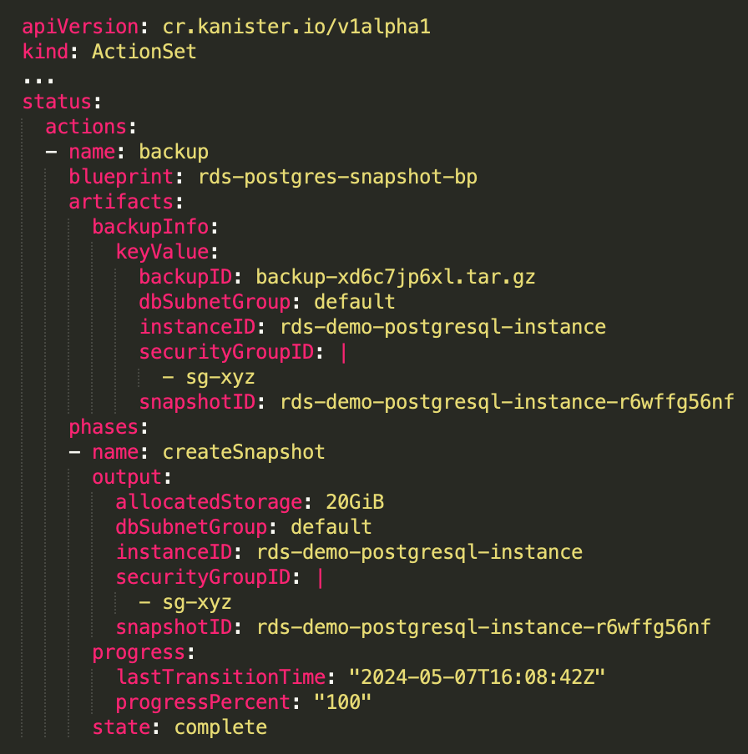
ActionSets track status
Each phase has progress and state
ActionSet produces artifacts

Slide 19
Demo: RDS backup

Slide 20
Demo infra setup
K8s
Db client
kanister
S3 bucket
RDS

Slide 21
Advantage of kanister approach
We shipped backup off from RDS into object storage
We ran all operations on K8s runners
We can have blueprints and for all services in the same catalog in K8s
We have backups metadata (actionsets) in K8s

Slide 22
Kanister integrations
Kanister functions
Providers supported
Custom Logic
KubeExec
KubeTask
Resource Lifecycle
Scale up/down workloads
KubeTask with kubectl command
Handle PVC
Backup/Restore/DeleteData
PrepareData
Volume Snapshots
Create/Restore/Delete
Amazon RDS
Create/Restore/Delete
ExportSnapshotToRegion
Object Storage
Amazon S3
S3 Compliant
Azure Blob
Google Cloud Storage
Block/File Storage (in-tree)
Amazon EBS/EFS
Azure Disk
Google Persistent Disk
IBM Disk
CSI

Slide 23
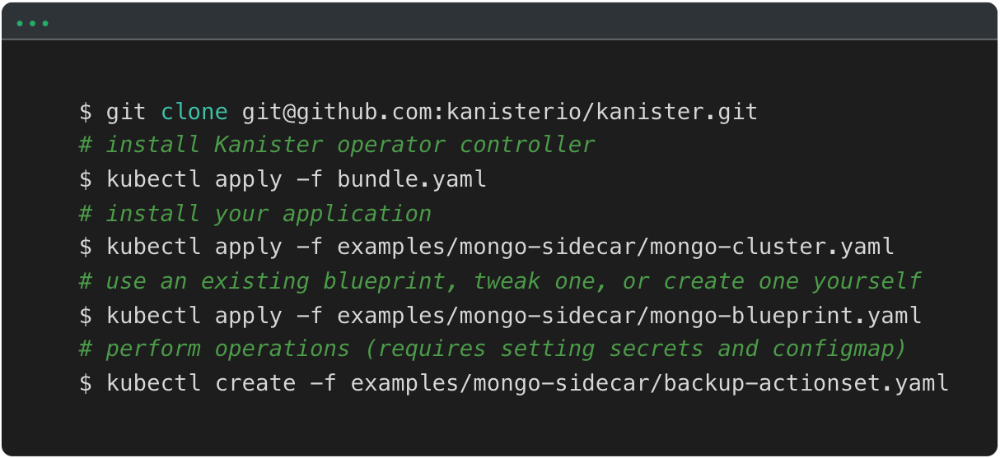



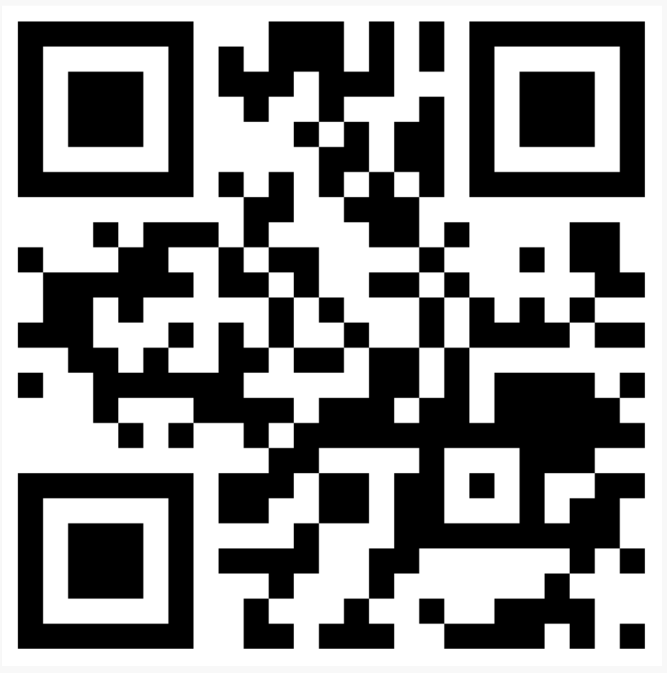
Thank you!
Kanister resources:
github.com/kanisterio/kanister
@kanisterio
#kanisterio
tiny.cc/kanisterio

